Slide 1
Foundation Subjects PP
What do our subjects mean?

Slide 2



School Drivers PowerPoint
Care of our environment - what does it mean?
How do we care for the world we live in?
How do we look after the world, the UK, Broadwas and the school with love and respect?
How can we allow our environment to feel valued, to grow and flourish?

Slide 3



School Drivers PowerPoint
Culture and Diversity - what does it mean?
What is important about a your own culture and our communities culture? How can we celebrate diversity?
How can we help culture and diversity to feel valued, to grow and to flourish?
How can we learn, reflect and respect the cultures of others?

Slide 4

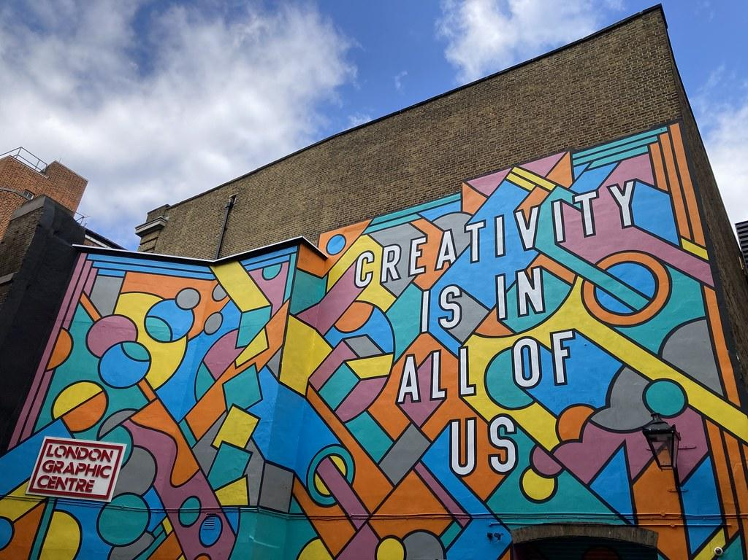
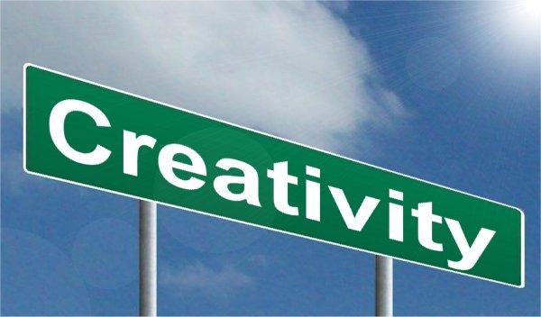
School Drivers PowerPoint
Creativity and Innovation - what does it mean?
How has the the world used creativity to adapt and develop?
How do we use creativity and innovation in the future so we can all grow and flourish?
What amazing innovations can we find out about?

Slide 5



School Drivers PowerPoint
Economy and Power - what does it mean?
How does the economy affect our world?
How can we use the economy to allow everyone to grow and flourish?
How has power changed over time? Has this allowed people to feel valued, to grow and flourish?

Slide 6

Foundation Subject PowerPoint
Science- What does it mean?
Science is the study of the physical and natural world through observation, experimentation, and the testing of ideas against the results and information we have collected.

Slide 7

Foundation Subjects PowerPoint
Science - what skill do we need to be a Scientist?
Knowledge we gather:
We gather knowledge on: Plants, Animals Including Humans, Living things and their Habitats, Everyday Materials, Seasonal Changes and Making Connections.
Skills we need to use to work Scientifically are:
Asking questions.
Observing
Using simple equipment
Performing tests
Identifying - finding a difference
Classifying - orgainising into groups
Suggesting answers to our questions
Gathering and recording information

Slide 8
Foundation Subjects PowerPoint
Computing - what does it mean?
Computing is the study of Computer Science. It teaches us how we can use our computer skills to help us use computers and digital devices really effectively! It also teaches us how these devices work!
We learn about how to use data and information, how digital systems work and how we can programme. It is also how we use digital technology to express ourselves and develop our own ideas for school and future jobs.

Slide 9
Foundation Subjects PowerPoint
Computing - what skill do we need as a Computer Scientist?
Skills we need to use:
Digital Literacy = how to use the internet safely and be a responsible digital citizen
Computer Science = how do we program and understand how computers and computer systems work
Information Technology = how do we use new technology in the most creative way
Computational Thinking = how do we use logic (have a system), abstraction (simplify ideas), algorithms (instructions), patterns, decomposition (break a problem down) and evaluation (how can we improve) and Approaches (tinkering, creating, debugging, persevering and collaborating)
Digital Literacy / Computer Science / Information Technology/ Computational Thinking

Slide 10

Foundation Subjects PowerPoint
Music - what does it mean?
Music is the study of our lives, it is the exploration of the sound that is all around us. Music allows us to help you understand, perform and create using sound.
Music has the power to bring communities together through whole-school singing, ensemble playing, experimenting with the creative process and, through the love of listening to friends and fellow pupils, performing. The sheer joy of music can feed the soul of our school community, enriching each of you while strengthening the shared bonds of support and trust which makes us a great school.

Slide 11
Foundation Subjects PowerPoint
Music - what skill do we need as a Musician?
Skills we need to use:
Singing songs with control and using voices expressively.
Listen with care and enjoy different recorded music
Explore sounds and identify, create and make sounds to accompany songs and play melodies.
Play instruments with control (tuned and untuned)
Develop performance skills

Slide 12
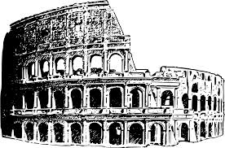
Foundation Subject PowerPoint
History - What does it mean?
History is the study of the past. The study of history helps make sense of humankind. It also helps people understand the things that happen today and that may happen in the future.

Slide 13
Foundation Subjects PowerPoint
History - what skill do we need as a Historian?
Chronological awareness:
Understand how time passes and order events in chronological order.
Historical Enquiry:
Ask and answer questions about historical events and people.
Use different evidence to increase our understanding.
Disciplinary Concepts:
Change and Continuity / Cause and Consequence / Similarities and Differences / Historical Interpretation / Sources
Describe and discuss simple changes in objects, people and lives
Find out about why people did things.
Discover some things stay the same in the past.
Find similarities and differences in their lives and those of the past.
Discover different ways the past is represented.

Slide 14

Foundation Subjects PowerPoint
Geography - What does it mean?
Geography is about understanding the world by: comparing locations; investigating; researching different sources; writing and talking about places; asking and answering questions.
Studying geography is so important for children, regardless of their age or stage of learning. Geography helps them to make sense of the world around them and piques their curiosity in places and people. Done well, it engages pupils in their world, often spurring them into action, and is fun!

Slide 15
Foundation Subjects PowerPoint
Geography - what skill do we need as a Geographer?
Skills we need to use:
Development of Locational Knowledge: 7 continents, 5 oceans, countries, oceans / seas and cities of the UK and where they are on a map.
Development of Place Knowledge: similarities and difference between Broadwas and a different place in the world
Development of Human and Physical Knowledge: study changes in weather, seasons in UK and hot and cold places around the world. Describe human and physical features of places.
Development of Geography Fieldwork Skills: ask and answer simple questions, observe and comment on things they have seen, measure by collecting measurable data, record by drawing, classify and photograph features and present likes and dislikes about a place.

Slide 16

Foundation Subject PowerPoint
RE - Religious Education - What does it mean?
Religious Education (RE) aims to develop children's understanding of the world's religions. Through religious education, children will learn about different religions and their traditions, practices and beliefs.
Religious education also promotes children's tolerance and mutual respect in a diverse society.

Slide 17
Foundation Subjects PowerPoint
RE - what skill do we need as a theologian?
Skills we need to use:
To be able to debate different points.
To be able to enquire about topics.
To be able to develop an understanding of Hermeneutics (interpretation of texts).
To be able to analyse texts.
To be able to interpret artwork and pictures.
To be able to develop Thinking Skills.
To be able to make connections.

Slide 18
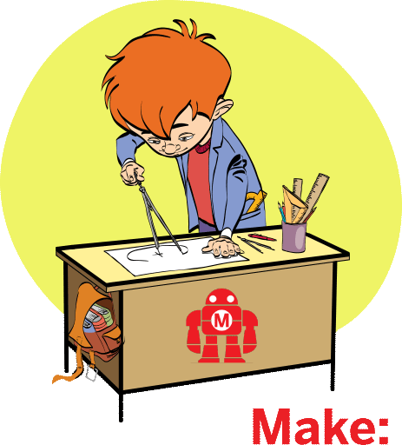
Foundation Subject PowerPoint
DT- What does it mean?
Design and technology is an inspiring, rigorous and practical subject. Using creativity and imagination, pupils design and make products that solve real and relevant problems within a variety of contexts, considering their own and others’ needs, wants and values. They acquire a broad range of subject knowledge and draw on disciplines such as mathematics, science, engineering, computing and art. Pupils learn how to take risks, becoming resourceful, innovative, enterprising and capable citizens. Through the evaluation of past and present design and technology, they develop a critical understanding of its impact on daily life and the wider world.

Slide 19
Foundation Subjects PowerPoint
Design Technology - what skill do we need to be a Designer or Engineer?
Skills
Design: talk, draw or follow templates to design products for themselves or others.
Make: to select from a wide range of materials and tools to perform practical tasks and explain why they have chosen these.
Evaluate: discuss how well products work that have been created or already exist.
Technical knowledge: build structures and explore mechanisms.

Slide 20

Foundation Subject PowerPoint
Art - What does it mean?
Art is the expression or application of human creative skill and imagination, typically in a visual form such as painting or sculpture, producing works to be appreciated primarily for their beauty or emotional power.

Slide 21
Foundation Subjects PowerPoint
Art - what skill do we need to be an artist ?
Skills
Practical: creatively use materials in drawing, sculpture and painting to share ideas
Theoretical: look at the differences and similarities in an artists work
Describe: features of their own and other peoples artwork
Evaluate: find out the messages and stories in art work and why it has been made
Analyse: how and why art is made

Slide 22

Foundation Subjects PowerPoint
PE - Physical Education - What does it mean?
Physical education inspires all pupils to succeed and excel in competitive sport and other physically-demanding activities as well as promoting healthy, active lifestyles.
Being physically confident supports health and wellbeing. Through PE lessons as well as extra-curricular sport and whole school ethos, children build character and embed values such as resilience, fairness and respect.

Slide 23
Foundation Subjects PowerPoint
Physical Education - what skill do we need to be an athlete?
Skills:
Physical Skills: development of fundamental movement skills including: balance, ball skills, jumping and landing, sending and recieving and footwork with fluency and performance.
Social Skills: to be able to lead, organise and improve others, help, understand and play with others.
Personal Skills: to take responsibility and embrace challenge, stay on track and keep trying.
Thinking Skills: to be able to analyse performance, make good decisions and describe how to improve and why.
Creative Skills: to observe, explore, compare, refine and adapt and adjust.
Health and Fitness: to explain how to exercise, prepare for activity and plan your fitness.

Slide 24

Foundation Subject PowerPoint
PSHE - What does it mean?
PSHE is Personal, social, health and economic education. It teaches children and young people how stay healthy, safe and prepared for life – and work – in modern Britain.
PSHE teaches children to:-
Take individual responsibility for their physical and mental wellbeing;
understand the risks of drugs and alcohol and how to stay safe online;
develop resilience, independence and responsibility;
develop the personal and social skills required to succeed in commerce and industry;
identify misleading information and be critical of misleading news or views they might encounter.

