Slide 1
Foundation Subjects PP
What do our subjects mean?

Slide 2



School Drivers PowerPoint
Care of our environment - what does it mean?
How do we care for the world we live in?
How do we look after the world, the UK and our immediate environment with love and respect?
How can we allow our environment to feel valued, to grow and flourish?

Slide 3



School Drivers PowerPoint
Culture and Diversity - what does it mean?
What is important about a your own culture and our communities culture? How can we celebrate diversity?
How can we help culture and diversity to feel valued, to grow and to flourish?
How can we learn, reflect and respect the cultures of others?

Slide 4

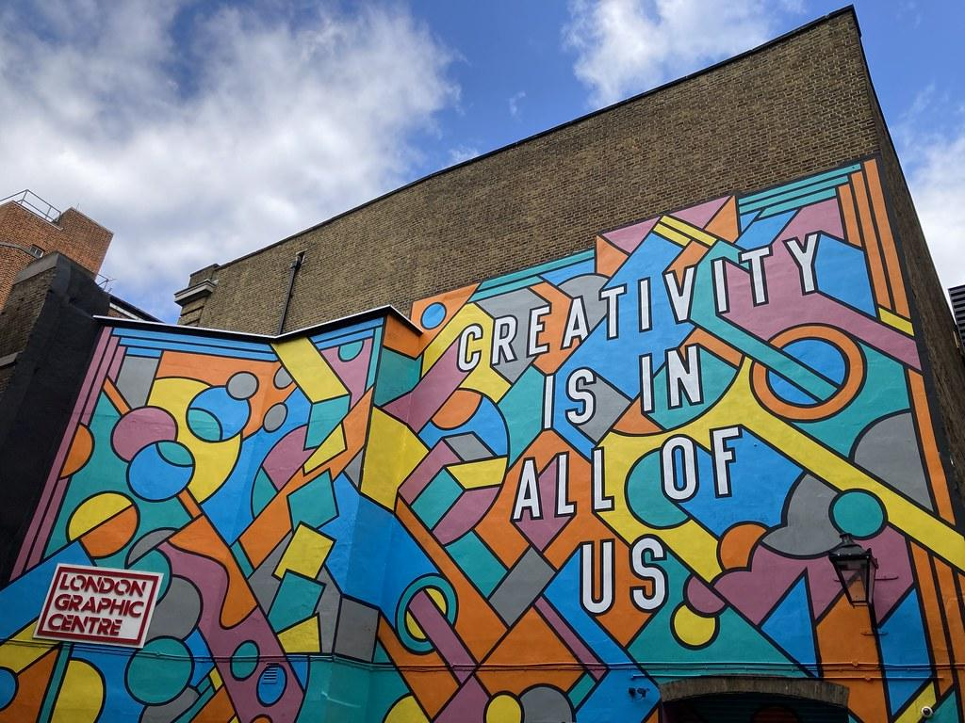
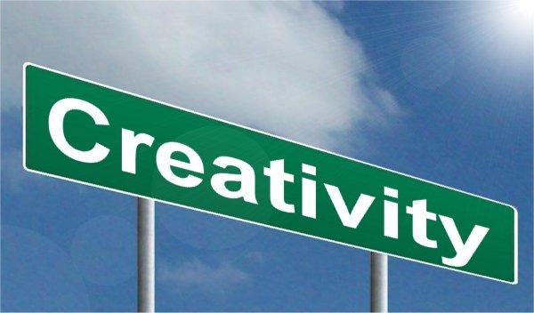
School Drivers PowerPoint
Creativity and Innovation - what does it mean?
How has the local community, the UK and then the world used creativity to adapt and develop?
How do we use creativity and innovation in the future so we can all grow and flourish?
How can we celebrate and value the innovations of our own community?

Slide 5



School Drivers PowerPoint
Economy and Power - what does it mean?
How does the economy affect our community, the UK and the wider world? How can we use the economy to allow everyone to grow and flourish?
How has the economy changed over time? Has this helped the community grow and flourish?
How has power transferred over time? Has this allowed people to feel valued, to grow and flourish?

Slide 6

Foundation Subject PowerPoint
Science- What does it mean?
Science is the systematic study of the structure and behaviour of the physical and natural world through observation, experimentation, and the testing of theories against the evidence obtained.

Slide 7

Foundation Subjects PowerPoint
Science - what skill do we need to be a Scientist?
Knowledge we gather:
We gather knowledge on: Plants, Animals Including Humans, Living things and their Habitats, Materials, Energy, Forces, Earth and Space and Making Connections.
Skills we need to use to work Scientifically are:
We learn to pose questions including variables.
To plan experiments and make predictions.
Observe qualitative data and measure quantitative data, with increasing accuracy and precision.
Research and record in the form of diagrams, graphs and tables with increasing complexity.
Use test results to make predictions to set up further comparative and fair test results
Grouping and Classifying
Analyse and draw conclusions.
Make evaluations and report findings in displays and presentations .

Slide 8
Foundation Subjects PowerPoint
Computing - what does it mean?
Computing is the study of Computer Science. It teaches us how we can use our computer skills to help us use computers and digital devices really effectively! It also teaches us how these devices work!
We learn about how to use data and information, how digital systems work and how we can programme. It is also how we use digital technology to express ourselves and develop our own ideas for school and future jobs.

Slide 9
Foundation Subjects PowerPoint
Computing - what skill do we need as a Computer Scientist?
Skills we need to use:
To be able to apply and develop abstraction (simplify systems by focus on essential), logical thinking (analyse and evaluate complex problems), spot patterns, development of algorithms (sequence of steps) and how to represent data. (data / CS / CT)
To be able to analyse problems and break them down (Decomposition) to be able to write and solve programming problems and solutions (programming / CS / CT)
To be able to review and evaluate new software and hardware and apply these when solving problems (multimedia / CS and IT).
To be a responsible user of online information and be a creative thinker when using digital technology (online work / DL).
Digital Literacy / Computer Science / Information Technology/ Computational Thinking

Slide 10
Foundation Subjects PowerPoint
Computing - what skill do we need as a Computer Scientist?
Skills we need to use:
Digital Literacy = how to use the internet safely and be a responsible digital citizen
Computer Science = how do we program and understand how computers and computer systems work
Information Technology = how do we use new technology in the most creative way
Computational Thinking = how do we use Concepts (logic, abstraction, algorithms, patterns, decomposition and evaluation) and Approaches (tinkering (play with technology until it works), creating, debugging (solve problems), persevering and collaborating)
Digital Literacy / Computer Science / Information Technology/ Computational Thinking

Slide 11

Foundation Subjects PowerPoint
Music - what does it mean?
Music is the study of our lives, it is the exploration of the sound that is all around us. Music allows us to help you understand, perform and create using sound.
Music has the power to bring communities together through whole-school singing, ensemble playing, experimenting with the creative process and, through the love of listening to friends and fellow pupils, performing. The sheer joy of music can feed the soul of our school community, enriching each of you while strengthening the shared bonds of support and trust which makes us a great school.

Slide 12
Foundation Subjects PowerPoint
Music - what skill do we need as a Musician?
Skills we need to use:
Singing songs with control and using voices expressively.
Listen with care and remember and move to music from memory.
Identify pulse and perform a rhythm
Explore sounds and identify, create and make sounds to accompany songs and play melodies.
Play instruments with control
Contribute to the composition of songs
Perform songs by reading and writing notation
Develop performance skills
Evaluate and appraise music heard and created

Slide 13
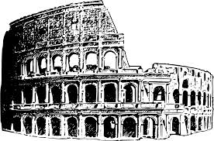
Foundation Subject PowerPoint
History - What does it mean?
History is the study of the past. The study of history helps make sense of humankind. It also helps people understand the things that happen today and that may happen in the future.

Slide 14
Foundation Subjects PowerPoint
History - what skill do we need as a Historian?
Skills we need to use:
Chronological awareness:
Sequencing events, understanding history is in periods of time, using dates and terms and noticing connections, using AD and BC, compare time periods from the past.
Concepts :
Continuity and Change: make links change and events, find reasons for change and continuity,
Cause and Consequence: explain reasons and results for historical events
Similarities and Differences: describe change, similarities and differences and links between time periods
Historical significance: compare and explain significance of people, life and events
Sources: value of sources, bias and power of secondary sources
Interpretations: find out how conclusions have been created and check the accuracy of evidence

Slide 15
Foundation Subjects PowerPoint
History - what skill do we need as a Historian?
Skills we need to use:
3. Historical Enquiry
Create and ask questions historically valid questions
Gather, organise and evaluate historical sources
Interpret historical findings, analyse and make connections
Evaluate and draw conclusions from historical findings
Communicate and present historical understanding

Slide 16

Foundation Subjects PowerPoint
Geography - What does it mean?
Geography is about understanding the world by: comparing locations; investigating; researching different sources; writing and talking about places; asking and answering questions.
Studying geography is so important for children, regardless of their age or stage of learning. Geography helps them to make sense of the world around them and piques their curiosity in places and people. Done well, it engages pupils in their world, often spurring them into action, and is fun!

Slide 17
Foundation Subjects PowerPoint
Geography - what skill do we need as a Geographer?
Skills we need to use:
Development of Locational Knowledge: locate countries and major cities in Europe, UK, North and South America using maps and atlases. Locate key human and physical features of countries and locate world’s biomes, vegetation belts and environmental regions. Use longitude and latitude and Meridian time zones.
Development of Place Knowledge: describe and explain similarities and differences in environmental zones studied, how humans have adapted to different areas and how climate alters trade land use and settlements.

Slide 18
Foundation Subjects PowerPoint
Geography - what skill do we need as a Geographer?
3. Development of Human and Physical Knowledge: describe and understand the key aspects of the six biomes and climate zones, describe the impact of climate changes and the key aspects of vegetation belts. Describe population change, trade links, distribution of natural resources push and pull factors in migration and humans impact on the environment.
4. Development of Geography Fieldwork Skills:
Questions: Create enquiry questions
Observe: plan how can they collect data
Measure: decide how to appropriately collect data
Record: use sketches, digital photos , interviews, real time live data etc
Present: draw conclusion, analyse and evaluate evidence

Slide 19

Foundation Subject PowerPoint
RE - Religious Education - What does it mean?
Religious Education (RE) aims to develop children's understanding of the world's religions. Through religious education, children will learn about different religions and their traditions, practices and beliefs.
Religious education also promotes children's tolerance and mutual respect in a diverse society.

Slide 20
Foundation Subjects PowerPoint
RE - what skill do we need as a theologian?
Skills we need to use:
To be able to debate different points.
To be able to enquire about topics.
To be able to develop an understanding of Hermeneutics (interpretation of texts).
To be able to analyse texts.
To be able to interpret artwork and pictures.
To be able to develop Thinking Skills.
To be able to make connections.

Slide 21
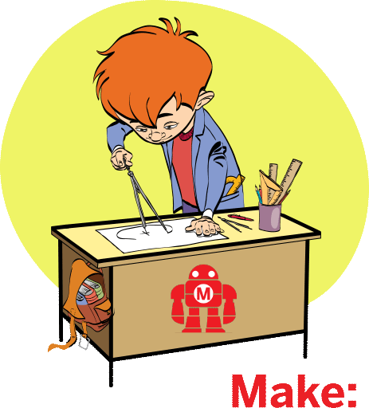
Foundation Subject PowerPoint
DT- What does it mean?
Design and technology is an inspiring, rigorous and practical subject. Using creativity and imagination, pupils design and make products that solve real and relevant problems within a variety of contexts, considering their own and others’ needs, wants and values. They acquire a broad range of subject knowledge and draw on disciplines such as mathematics, science, engineering, computing and art. Pupils learn how to take risks, becoming resourceful, innovative, enterprising and capable citizens. Through the evaluation of past and present design and technology, they develop a critical understanding of its impact on daily life and the wider world.

Slide 22
Foundation Subjects PowerPoint
Design Technology - what skill do we need to be a Designer or Engineer?
Design: to be able to research and develop design criteria to create innovative, functional and purposeful models. Use discussions, sketches and prototypes to explain.
Make: select and use a wide range of tools and materials to perform practical tasks based on their properties.
Evaluate: evaluate their own products and those of others and how these can be improved. Understand how key ideas have altered the world.
Technical knowledge: develop understanding of how to strengthen models, use mechanical levers, electrical systems and computer programming.

Slide 23

Foundation Subject PowerPoint
Art - What does it mean?
Art is the expression or application of human creative skill and imagination, typically in a visual form such as painting or sculpture, producing works to be appreciated primarily for their beauty or emotional power.

Slide 24
Foundation Subjects PowerPoint
Art - what skill do we need to be an artist ?
Skills
Generating ideas – encouraging autonomy; developing creativity; generating original ideas through experimentation.
Making skills – becoming familiar with the formal elements of art; developing practical knowledge of a variety of media and materials; exploring and testing out different creative methods, tools and techniques.
Evaluating and analysing – discussing art using appropriate language to analyse a creative work; considering how art is studied, discussed and judged; examining what art is and why people make it.
Knowledge of artists – exploring traditional and contemporary artists, craft-makers and designers from diverse communities; studying the materials, processes and meanings of these artists.
Using sketchbooks – documenting and trying out different ideas and media; evaluating and evolving the children’s artwork.

Slide 25

Foundation Subject PowerPoint
MFL - What does it mean?
The study of Modern Foreign Languages is the development of language knowledge, apart from English, that is spoken in different countries around the world today.

Slide 26
Foundation Subjects PowerPoint
MFL - what skill do we need to be a linguist?
Skills
Children will learn Phonics, Grammar and Vocabulary from the foreign language.
Recognising learnt vocabulary when listening or reading
Spotting cognates (words which have the same origin or are in some way similar) and near- cognates -
Using context and their own knowledge of the world to predict the meaning of unknown words
Considering word order to anticipate the meaning of words

Slide 27

Foundation Subjects PowerPoint
PE - Physical Education - What does it mean?
Physical education inspires all pupils to succeed and excel in competitive sport and other physically-demanding activities as well as promoting healthy, active lifestyles.
Being physically confident supports health and wellbeing. Through PE lessons as well as extra-curricular sport and whole school ethos, children build character and embed values such as resilience, fairness and respect.

Slide 28
Foundation Subjects PowerPoint
Physical Education - what skill do we need to be an athlete?
Skills:
Physical Skills: development of fundamental movement skills including: balance, ball skills, jumping and landing, sending and recieving and footwork with fluency and performance.
Social Skills: to be able to lead, organise and improve others, help, understand and play with others.
Personal Skills: to take responsibility and embrace challenge, stay on track and keep trying.
Thinking Skills: to be able to analyse performance, make good decisions and describe how to improve and why.
Creative Skills: to observe, explore, compare, refine and adapt and adjust.
Health and Fitness: to explain how to exercise, prepare for activity and plan your fitness.

Slide 29

Foundation Subject PowerPoint
PSHE - What does it mean?
PSHE is Personal, social, health and economic education. It teaches children and young people how stay healthy, safe and prepared for life – and work – in modern Britain.
PSHE teaches children to:-
Take individual responsibility for their physical and mental wellbeing;
understand the risks of drugs and alcohol and how to stay safe online;
develop resilience, independence and responsibility;
develop the personal and social skills required to succeed in commerce and industry;
identify misleading information and be critical of misleading news or views they might encounter.

