Slide 1

Worcestershire West
Weekly Physical Activity Programme
Floor Tennis
Trap & Tap
Pirate Catch
High Five Rallies
Double Trouble
Switch Catch
Hand Ball Rally
Monday 29th June - Friday 3rd^{th} July 2020

Slide 2
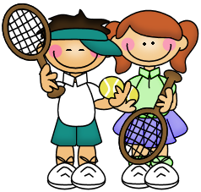
Floor Tennis
How to Play
With a racket each, stand facing your partner a few metres apart. With the racket in your right hand push the
ball to your partner making sure it stays on the floor. Your partner has to stop the ball with their racket in their
right hand in front of their shoes. With their racket they push the ball back to you. You now have to stop
the ball with the racket in your left hand and in front of your shoes before pushing the ball back with your left
hand. After you push the ball to your partner, recover back to a central position.
To make things easier for younger children, you could move closer together. Alternatively players could play with their dominant hand only.
If you don’t have a tennis racket, could you use a frying pan?

Slide 3

Trap and Tap
How to Play
Stand facing your partner a few metres apart. You have your racket and your partner has a ball. Your
partner under arm throws the ball to you, use the face of your racket and spare hand to catch the ball in
front of your shoes.
Drop the ball and tap it back with your racket for your partner to catch after the bounce. Make sure you
try to catch and tap the ball using your left hand during your next attempt. Switch hands after each
attempt.
Challenge Yourself
Could you run around a cone before you catch the ball?
Could you touch the floor before you catch the ball?

Slide 4
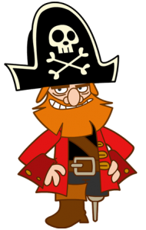

Pirate Catch
How to Play
Stand facing your partner a few metres apart. Your partner under arm throws the ball to you and calls
out “right” or “left.” You must move and try and catch the ball with your racket after the bounce,
standing on one leg only. You then drop the ball off your racket and hit it back to your partner whilst
balancing on one leg. After you hit the ball to your partner, try to recover back to a central position
before they catch.
To make things easier for younger children, you could move closer together. Alternatively players could play with their dominant hand only.
If you don’t have a tennis racket, could you use a frying pan?

Slide 5

High 5 Rallies
How to Play
With a racket each, stand facing your partner a few metres apart. Your partner has to drop the
ball in front of their shoes and tap it up after the bounce, towards you. You have to catch the ball,
if you catch it that's a rally of one and you can give your partner a high five by touching rackets.
Now you drop the ball in front of your shoes and tap it up, again, after it bounces, to your
Partner, they tap it back to you after the bounce and if you catch it that's a rally of two and
Another high five! See if you can build up to a rally of five.
Challenge Yourself
You could move further apart.
You could have a target area and if the ball
enters the target area, you score double points.

Slide 6

Double Trouble
How to Play
With a racket each, stand facing your partner a few metres apart. With rackets in your right
hand, at the same time both of you push a ball to each other making sure it stays on the floor.
You both have to stop the ball with your racket in your right hand and in front of your shoes.
Repeat but sending and stopping the ball with the racket in your left hand. After you push the
ball to your partner, recover back to a central position.
Challenge yourself
By not stopping the ball or alternating between both hands.
After you push the ball to your partner, can you
successfully run around a cone and stop the
incoming tennis ball?

Slide 7
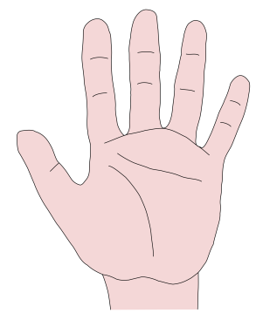

Hand Ball Rally
How to Play
With a large ball and standing a few metres apart, roll the ball to your partner shouting “left” or
“right.” Using the palm of their hand your partner has to push the ball back to you using the
correct hand. After a few attempts, switch roles.
You can make it more challenging by rolling the ball to one side and calling the other side hand.
Challenge Yourself
Your partner has to stop the ball using the palm of their hand, move around the ball with small,
light steps and then send the ball back to you using the hand that you called out.
After you push the ball to your partner, recover back to
a central position.

Slide 8

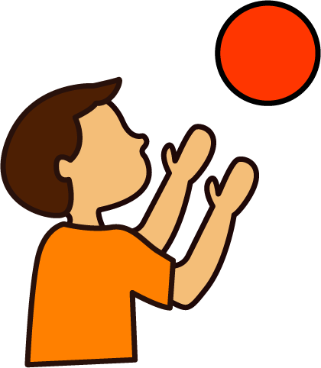
Switch Catch
How to Play
Stand facing opposite your partner, close together. Both of you have a ball, hold the ball out in
front of you at shoulder height with straight arms. At the same time both of you drop the ball and
try to catch each others ball after the bounce.
Count down from 3-2-1 to make sure you drop at the same time.
Challenge Yourself
You could use different sized balls. E.g. 1 tennis ball and 1 football.
You could try and catch each others ball using only 1 hand.
You could try and touch the floor before catching each others ball.

