Slide 1

ECO Assembly Autumn Term 2024
How can we help our environment? What can we do!

Slide 2
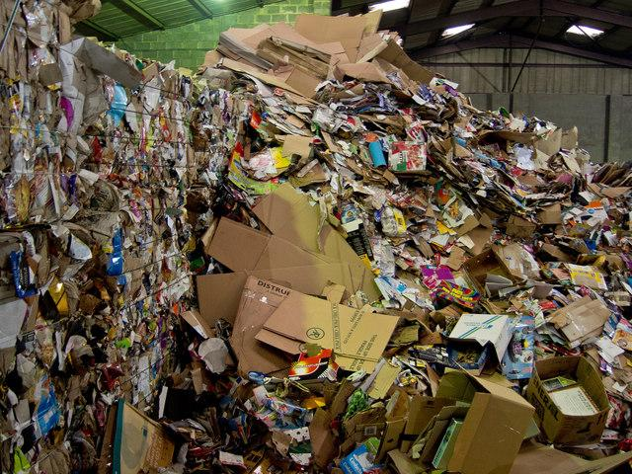
ECO Assembly Autumn Term 2024
Challenge 1: Recycling in School
Paper into the recycling bin and nothing else!
Plastic goes in the recycling bin in the library!
Wish
Have a plastic bin in every class. Asking the Governors.
So What?
Paper and plastic in the right bin to increase recycling and reduce Global Warming!

Slide 3

ECO Assembly Autumn Term 2024
Challenge 2: Lights of around the school
If you leave a room the teacher needs to turn off the lights.
If you leave the room the teacher needs to turn off the Smartboard.
Why?
To save electricity that will reduce Global Warming.
So What?
Turn off the lights and Smartboard!
ECO Ambassadors are going to monitor and tell teachers off if not done!

Slide 4
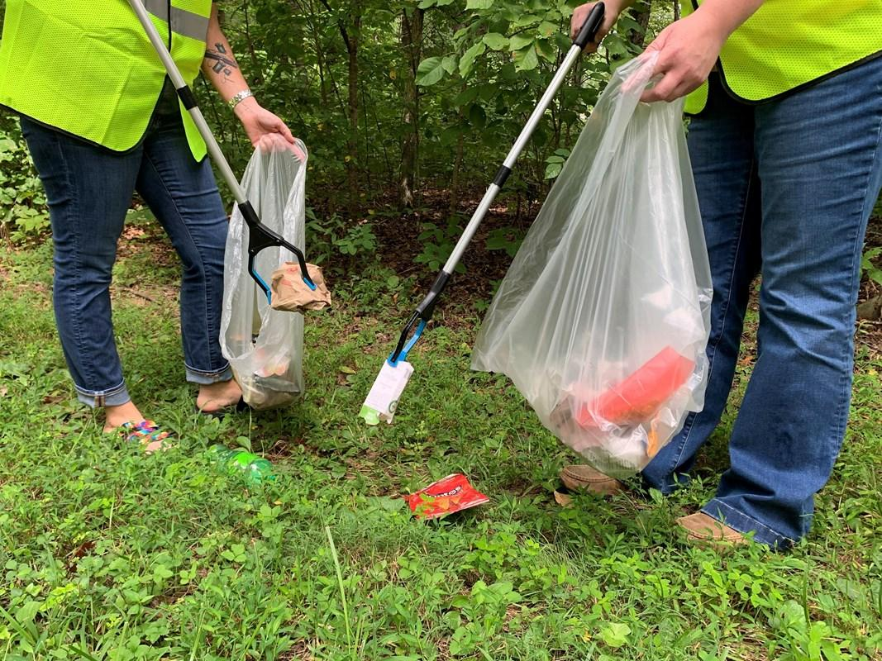
ECO Assembly Autumn Term 2024
Challenge 3: Litter on the playground
Too much paper and wrappers are being left out and not going in the bin!
Why?
Keep the environment safe for the local wildlife.
So What?
Regular litter picks by ECO Ambassadors
ECO Ambassadors are going to monitor!
Litter picking club in school and village!

