Slide 1


School Vision and Values
Broadwas CE Primary School

Slide 2
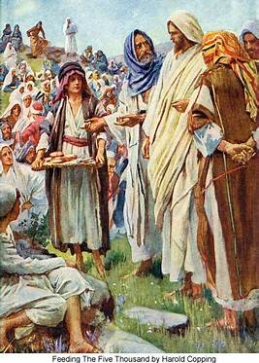
School Vision and Values
As a church school, rooted in Christian values, our vision is inspired by the miracle of the loaves and the fishes. This demonstrates God’s provision and care for us all through the generosity of one young child.

Slide 3
School Vision
By valuing each individual within our school family, we enable everyone to grow and flourish at Broadwas by providing a relevant, inclusive and knowledge rich curriculum in a stimulating, fun and loving environment.

Slide 4
Living Our Values Every day!
Love - We love God and one another as Jesus taught us.
Respect - We respect everyone and everything.
Friendship - We trust and value our friends.
Forgiveness - We learn to forgive those who may have hurt us.
Truthfulness - We tell the truth even when it is hard to do so.
Creativity - We celebrate the creative spirit in all of us.

Slide 5
School Vision!
The Greatest is Love
Our vision and aims place ‘love’ at the heart of our school and impact directly on the way we care for the children, parents and staff in our school community. The value of ‘love’ also encompasses so many other distinctly Christian values and indeed, many of our school’s core values.
There is a key passage from scripture that emphasises the importance of love. We see this in an extract from 1 Corinthians 13: 4-7
‘Love is patient, love is kind. It does not envy, it does not boast, it is not proud. It does not dishonour others, it is not self-seeking, it is not easily angered, it keeps no record of wrongs. Love does not delight in evil but rejoices with the truth. It always protects, always trusts, always hopes, always perseveres.’

Slide 6
Broadwas Spirituality!
Spirituality is about understanding that we are an integral part of something bigger. It’s a connection, rooted in love, with ourselves, others and God which supports an understanding of our place in the world. Practising Spirituality brings a sense of perspective, meaning and purpose to our lives.

Slide 7
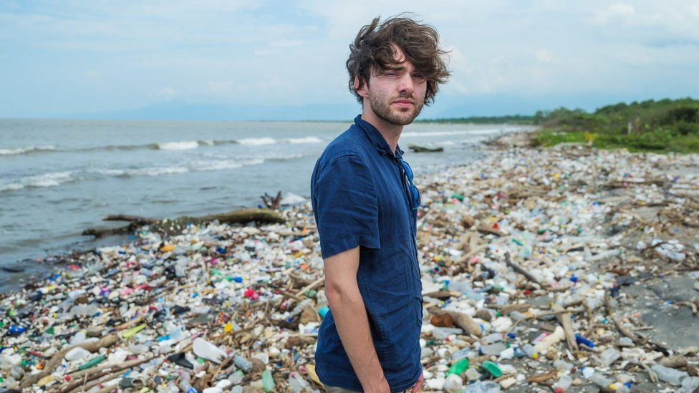
Broadwas Courageous Advocacy!
Boyan Slat
Inventor of a floating plastic trap and an inspiration to us all!

Slide 8
Broadwas Courageous Advocacy!
Boyan Slat
Boyan is a a young Dutch inventor who has a passion to clean up floating plastic from the Pacific Ocean. He has developed a floating device to trap plastic waste moving into rivers before it reaches the high seas. Boyan Slat was just 18 years old when he invented a system for catching waste in the ocean by developing test models in his fish tank at home! He is now on a mission to rid the world’s oceans of plastic pollution!

Slide 9
Broadwas Spirituality!
Awe and Wonder - Appreciate beauty and wonder in the world!
Connection and Belonging - Show generosity to others!
Curiosity and Mystery - Be curious about the big questions in life!
Self Awareness - Be aware of ourselves and who we are!
Prayer and Worship - Be aware that many things transcend us!
Space / Process / Imagination / Relationships / Intimacy / Trust

Slide 10
Year 6 Vision and Values Challenge!
How did the Vision and Values help you on your journey through the school?
What does the Vision mean to you?
How does the Bible story help of the Loaves and Fishes support you?
How do each of the Values help you?
What Bible stories have helped you during your time at school?
What does it mean to ‘Live Our Values Everyday’?

