Slide 1


‘How we keep children safe!’
Head’s Drop In - 3rd October 2023

Slide 2
‘How we keep children safe’
Aim of this meeting:
To be able to explain to you all the measures, processes and actions that we take in school to ensure all children are safe.
At Broadwas CE Primary School we recognise our moral and statutory responsibility to safeguard and promote the welfare of all pupils. We endeavour to provide a safe and welcoming environment where children are respected and valued. We are alert to the signs of abuse and neglect and follow our procedures to ensure that children receive effective support, protection and justice. Child protection forms part of the school’s safeguarding responsibilities.
All staff have responsibility to provide a safe environment in which children can learn.

Slide 3

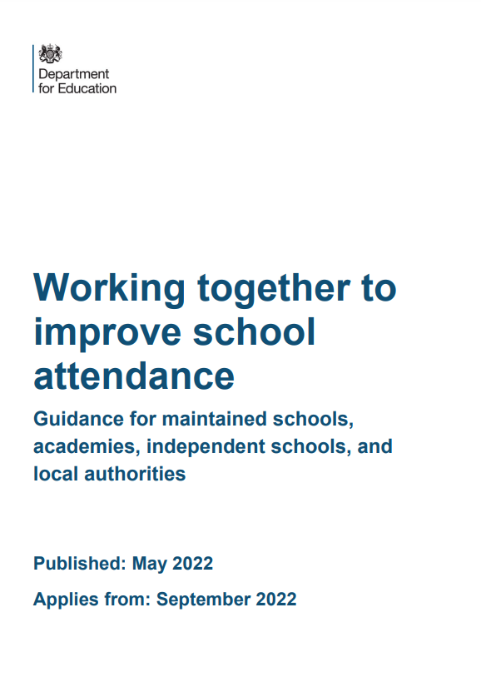

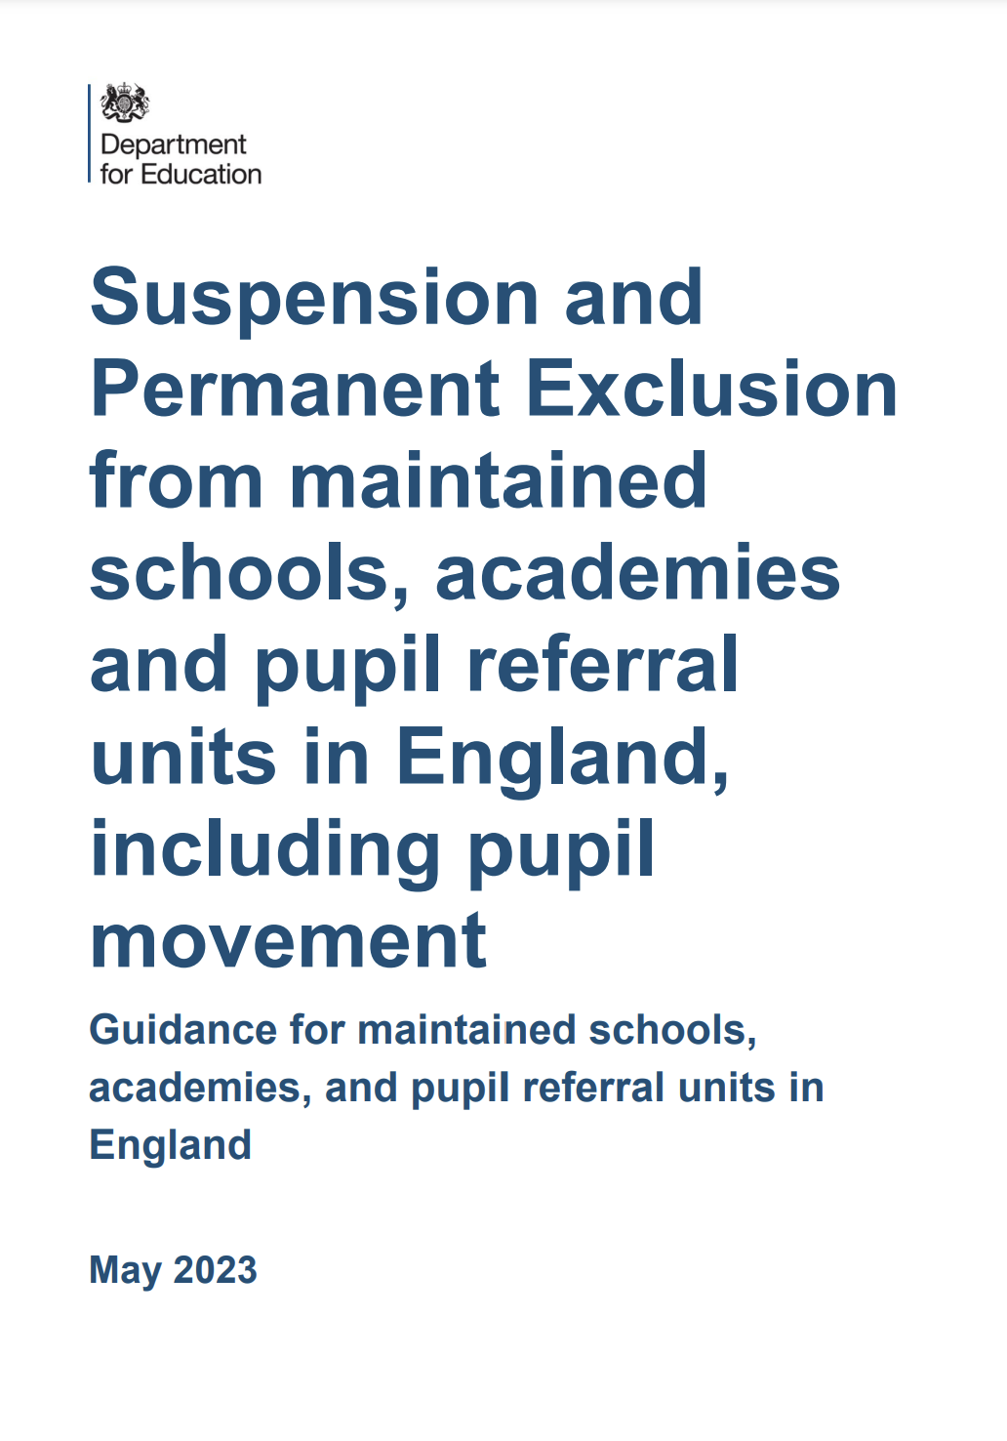


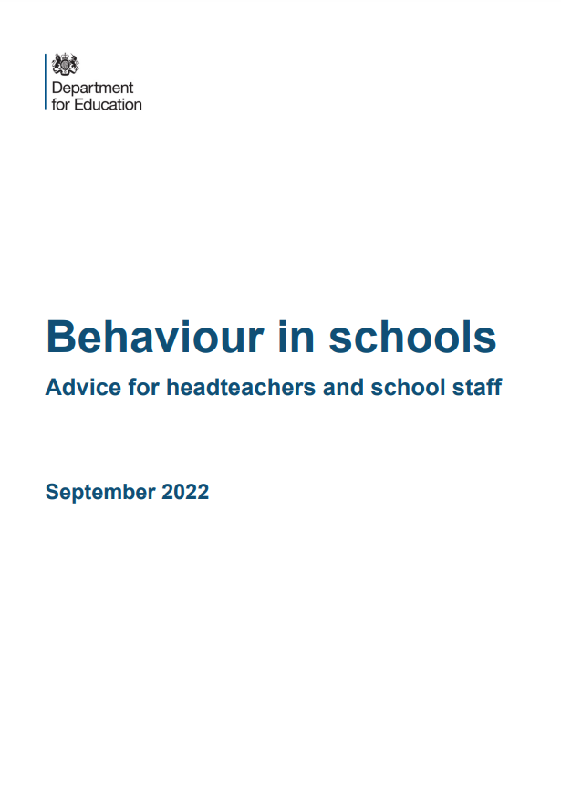
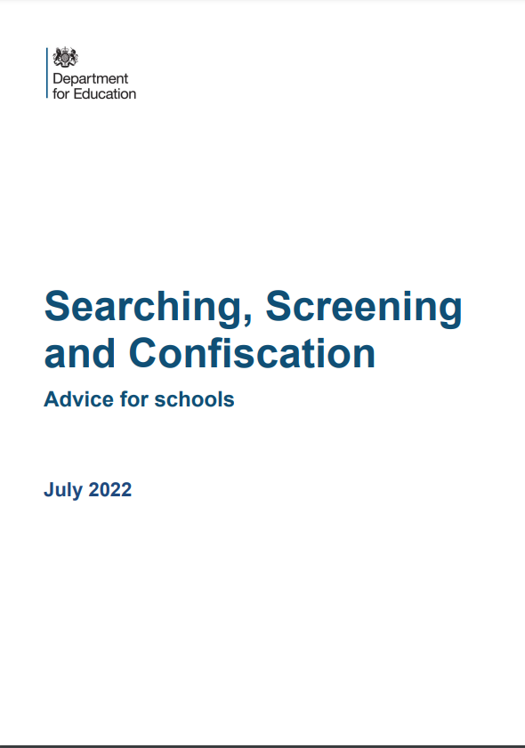


Notes:
Highlight the many pieces of guidance that schools and colleges need to follow that all have links to safeguarding considerations.

Slide 4
‘How we keep children safe’
How do each member of staff keep the children safe in school:
A listening school = we deal with all issues raised by children and parents.
Curriculum = teaching children through the curriculum via the PSHE curriculum based on SCARF curriculum.
Behaviour = continuously observing and monitoring behaviour.
Attendance monitoring = ensuring we know where children are if absent and supporting children return to school.
Governors = full reports to Governors during FGB meetings whilst maintaining confidentiality.
SEND and Inclusion = supporting children with SEND in school. We are an inclusive school and support all to flourish and thrive!
Mental Health and Wellbeing = teaching and support via the curriculum and staff within school.

Slide 5
‘How we keep children safe’
How do each member of staff keep the children safe in school:
Child Protection = protecting all children in school who may have suffered or be likely to have suffered harm.
Online Safety = teaching and support via the curriculum and staff within school. Online filtering system in school and focus on understanding CONTENT, CONTACT, CONDUCT and COMMERCE.
Health and Safety = monitoring the safety of the school both inside and outside of the building.
Whistle blowing = staff’s understanding of how to raise concerns.
Safer Recruitment = Key staff and Governors are trained to ensure safer recruitment is in place.

Slide 6
‘How we keep children safe’
How do staff stay up to date on ‘Keeping Children Safe in School?
Staff are all trained on current KCSIE measures every year.
CPD is delivered on specific features of identifying harm. What types of harm we may encounter and what signs these may present.
Staff are also trained on the processes of raising concerns to the DSL team.
DSL Team have yearly updates on Safeguarding and regular training to ensure their level of understanding is always relevant and up to date.
GET SAFE training on identifying potential radicalisation signs.
Police termly update on Contextualised Safeguarding issues.
Recent training in: Operation Encompass, FGM, Forced Marriage and CSE.

Slide 7
‘How we keep children safe’
How do staff raise a concern in school?
Staff monitor children at all times. All classes are discussed each week in Staff Meetings with teachers.
If they have a concern they will raise to DSL team.
If a child brings a concern to a member of staff they will listen. They will reassure and make it clear they are taking all that is said seriously.
They will explain what they are going to do next.
They will relay the information to a member of the DSL team.
They will make a factual record, on CPOMS, of what the child has said.

Slide 8

Notes:
How to find information about Early Help via the WCF website – the Family Hub

Slide 9
‘How we keep children safe’
How do staff raise a concern in school?
DSL team are able to access support from the LA:
Early Help
LA Safeguarding Team via the Family Front Door
School will then work closely with other agencies to ensure the child is protected and safe.
Remember: ‘Doing nothing is not an option’
Safeguarding is everyone’s responsibility

