Slide 1


‘How we keep support behaviour in school’
Head’s Drop In - 1st December 2023

Slide 2
‘How we support children’s behaviour in school’
Aim of this meeting:
To be able to explain to you all the support we give children in school with all types of behaviour. This includes:
How we reward children in school?
Sanctions we use in the school.
What Learning Behaviours we teach in school?
How we teach Emotional Behaviour in school?

Slide 3

‘How we support children’s behaviour in school’
How do we reward children in school with positive behaviour:
Verbal Praise
Class Reward System
House Points
School Responsibilities
Head teacher Stickers
Head teacher Certificates
Special Awards Certificates

Slide 4

‘How we support children’s behaviour in school’
How do we support children in school with negative behaviour:
Verbal Warning (focus on the misbehaviour not the child)
Red ‘W’
Missing playtime, standing next to teacher, remove privileges
Speak to the Head teacher or senior staff
Contacting parents
Support from Behavioural and Wellbeing Practitioner and TISUK
Specialist Services (CCN Team, PRU Team, Ed Psychologists etc)
Behaviour Plans and or Part Time Timetables

Slide 5
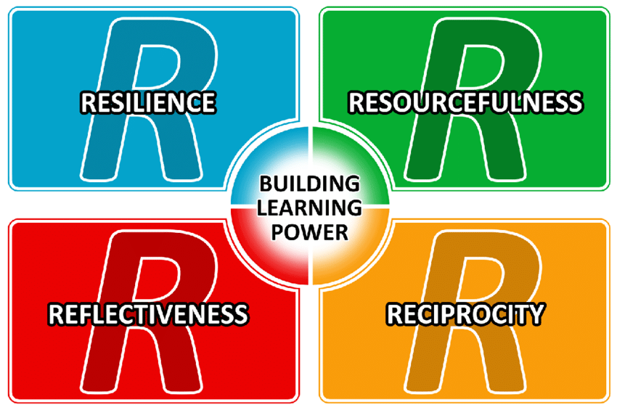
‘How we support children’s behaviour in school’
How do we support children in school with learning behaviour:
Building Learning Power
Being Resourceful = know what to do when you are stuck!
Being Resilient = Not giving up!
Being Reflective = think about yourself as a learner!
Being Reciprocal = to learn from others and ourselves!
All supported via Celebration Assembly, mascots for each ‘R’ developed by the children and earned via lessons.

Slide 6

‘How we support children’s behaviour in school’
How do we support children in school with emotional behaviour:
Zones of Regulation
Being Red = Feeling overwhelmed and angry (Stop)
Being Blue = Feeling sad or unhappy (Rest)
Being Yellow = Feeling excited (Caution)
Being Green = Feeling calm (Good to Go)
All supported via Celebration Assembly, mascots for each ‘R’ developed by the children and earned via lessons.

