Slide 1

Internet Safety Day
Friday 9th February 2024

Slide 2
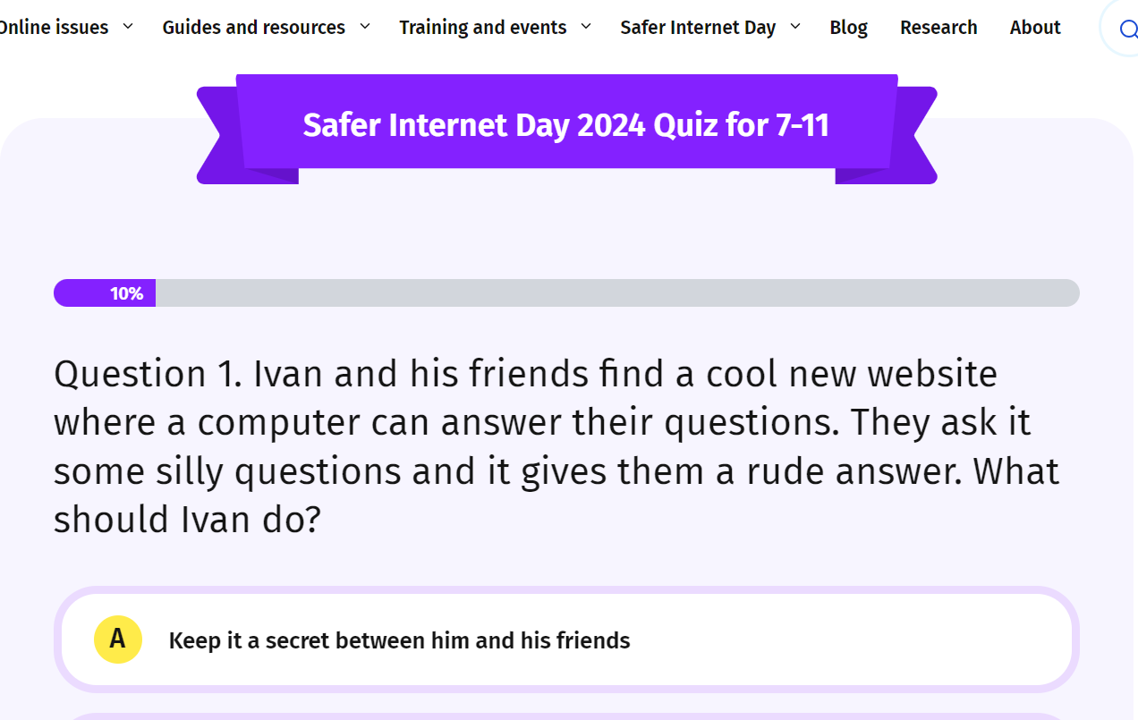
Internet Safety Day 2024
https://saferinternet.org.uk/safer-internet-day/safer-internet-day-2024/quiz-for-7-11-year-olds

Slide 3
Internet Safety Day 2024 - Key Issues
What are the challenges that face us now?
Screen Time?
Addiction to games or being online?
Appropriate age of the games / APPs
Social Media
Peer influence and pressure

Slide 4
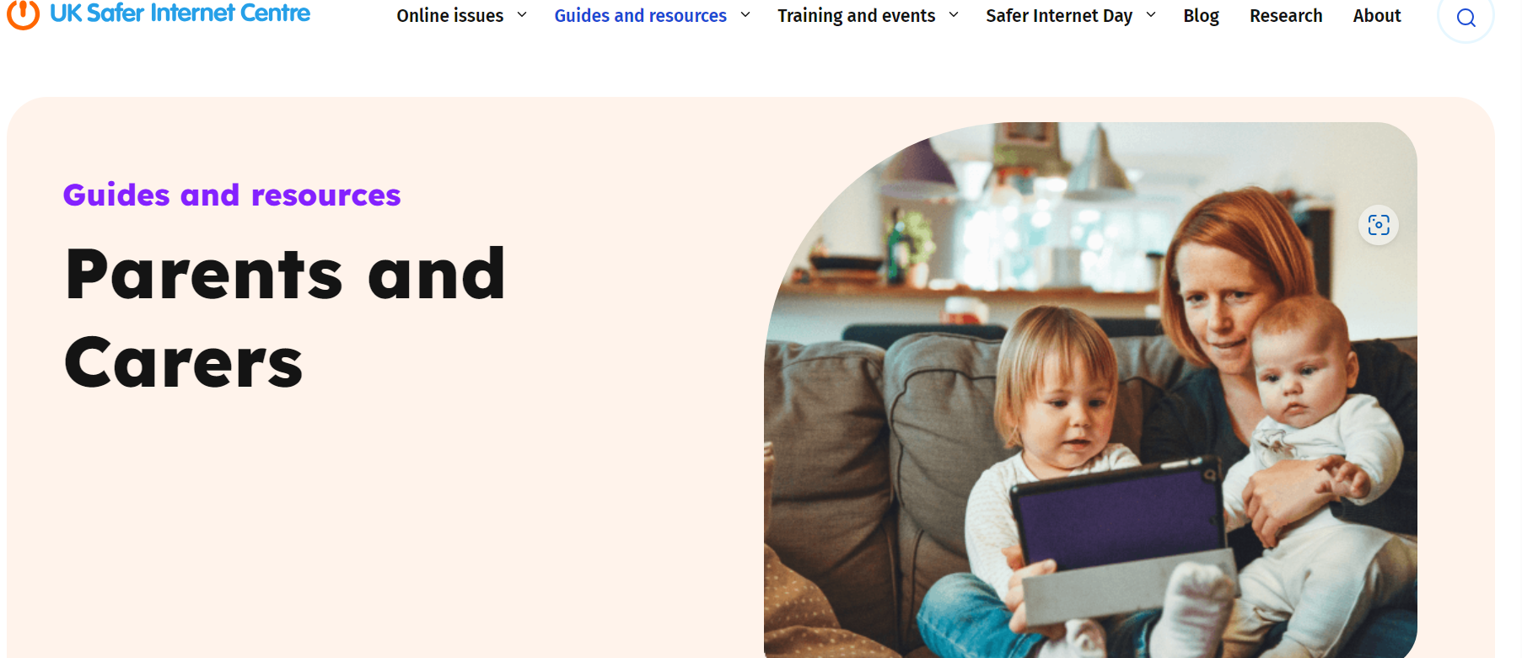
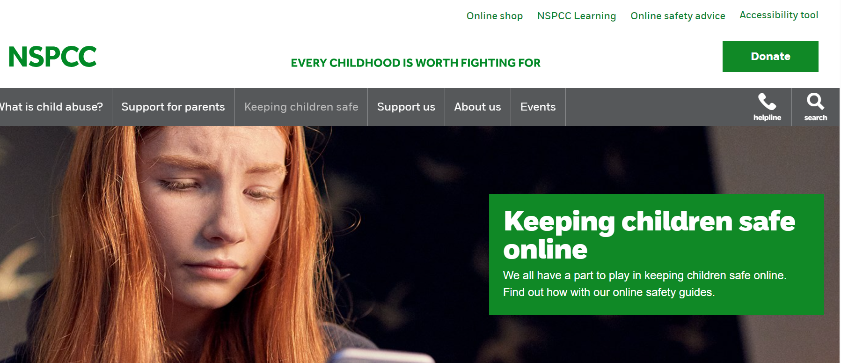
Internet Safety Day 2024 - Resources
Keeping children safe online | NSPCC
Parents and Carers - UK Safer Internet Centre

Slide 5
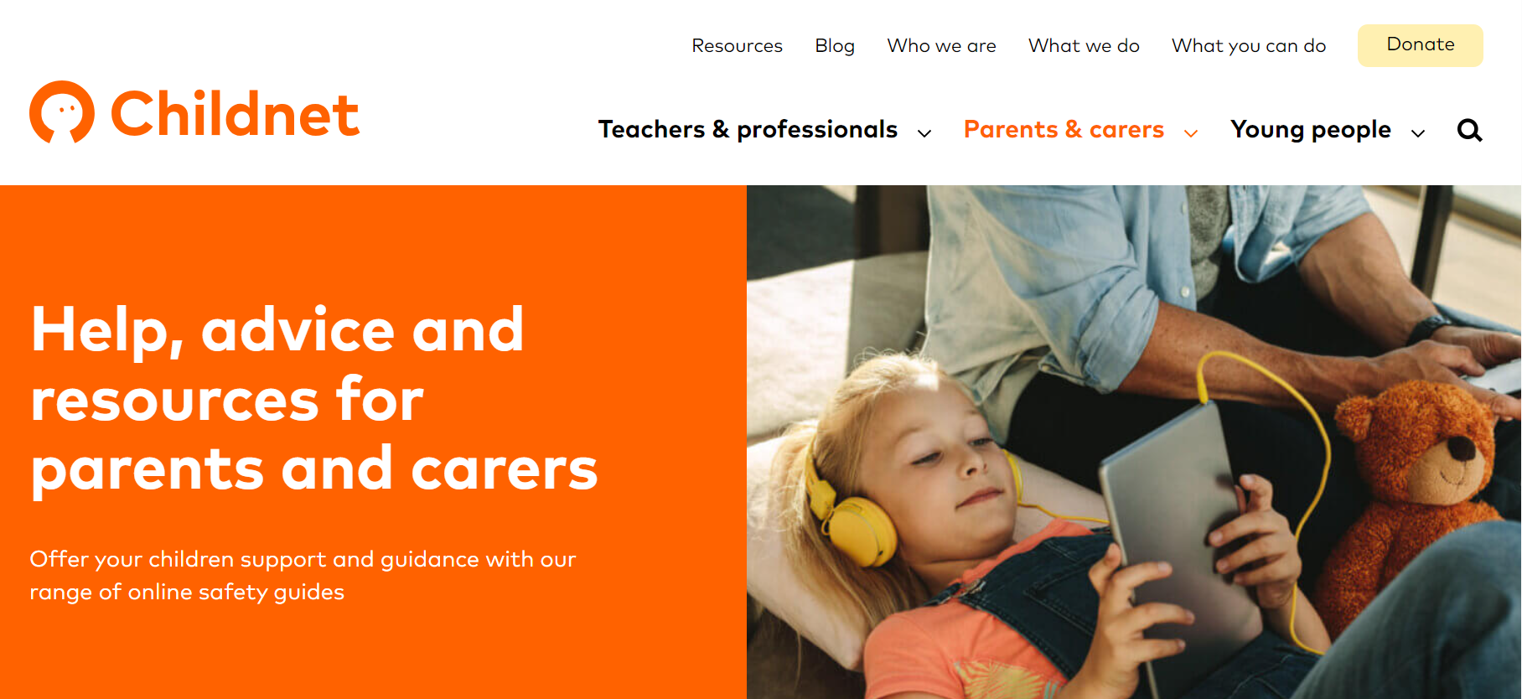
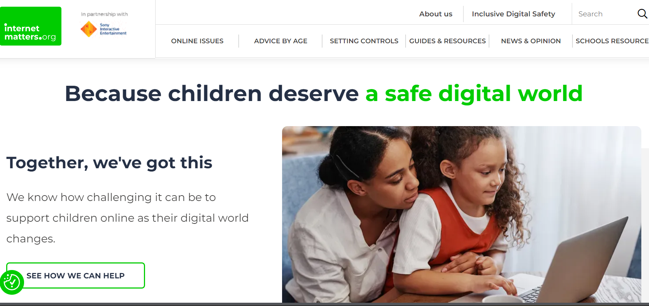
Internet Safety Day 2024 - Resources
Keep Children Safe Online: Information, Advice, Support - Internet Matters
Parents & carers | Childnet

Slide 6
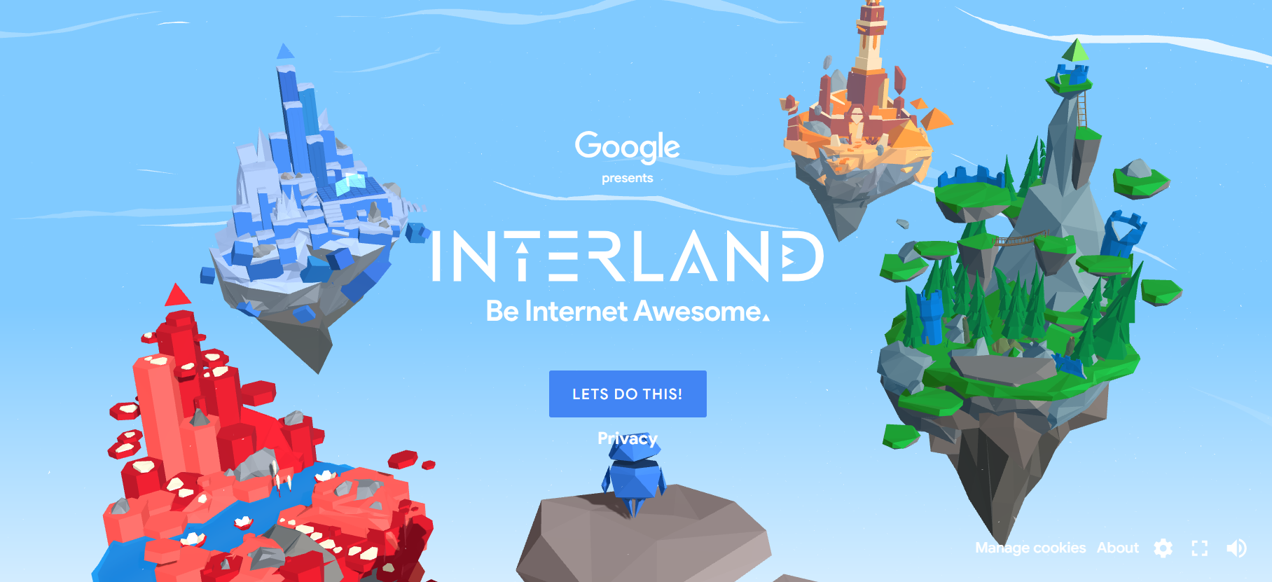
Internet Safety Day 2024 - School Sites

Slide 7
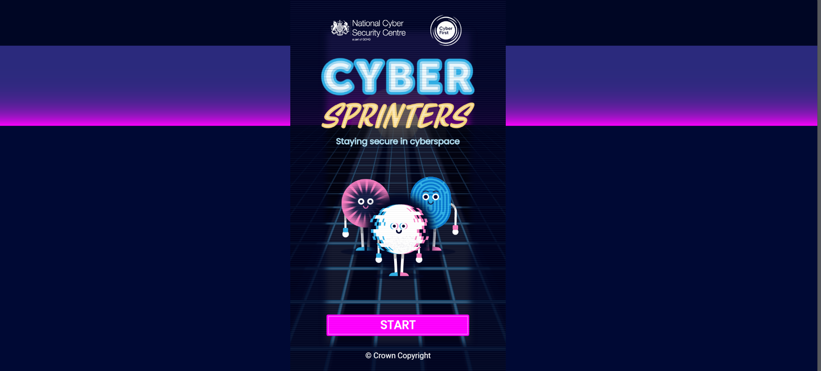
Internet Safety Day 2024 - School Sites

Slide 8
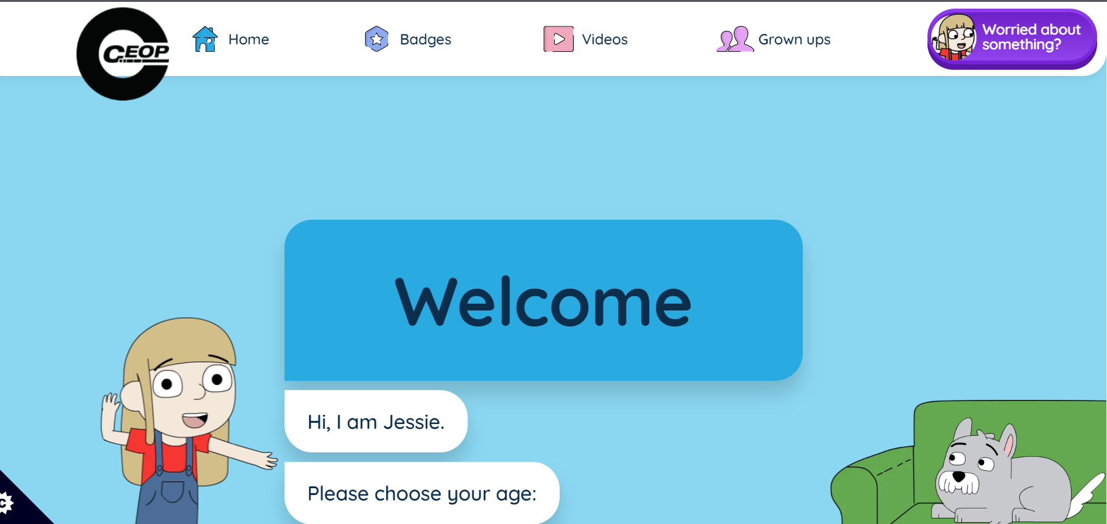
Internet Safety Day 2024 - School Sites

Slide 9
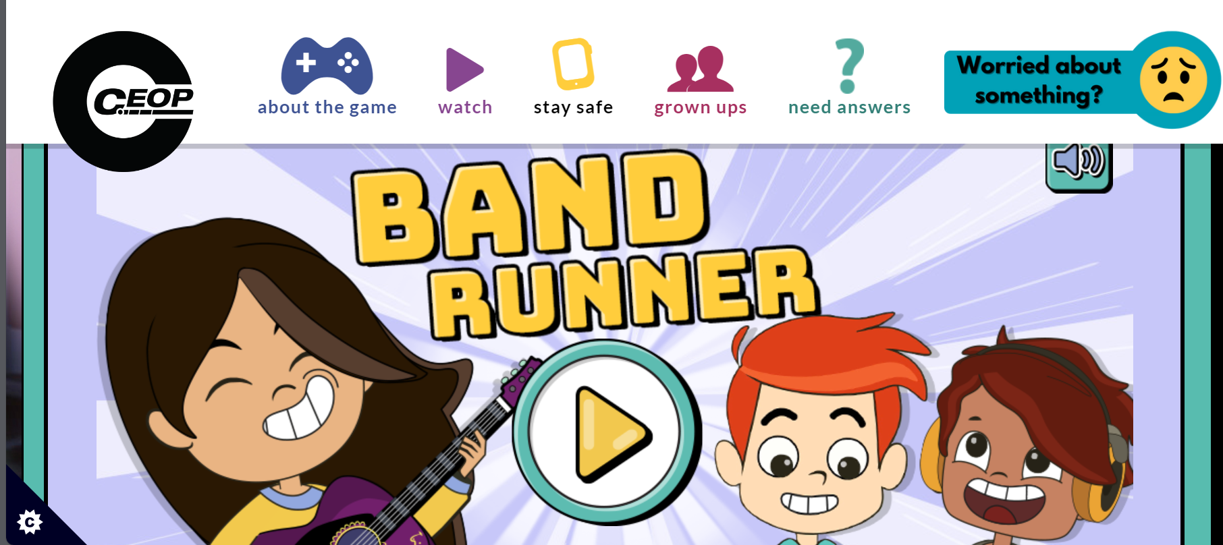
Internet Safety Day 2024 - School Sites

